Slide 1
Overcoming my imposter syndrome
Neil Mispelaar

Slide 2
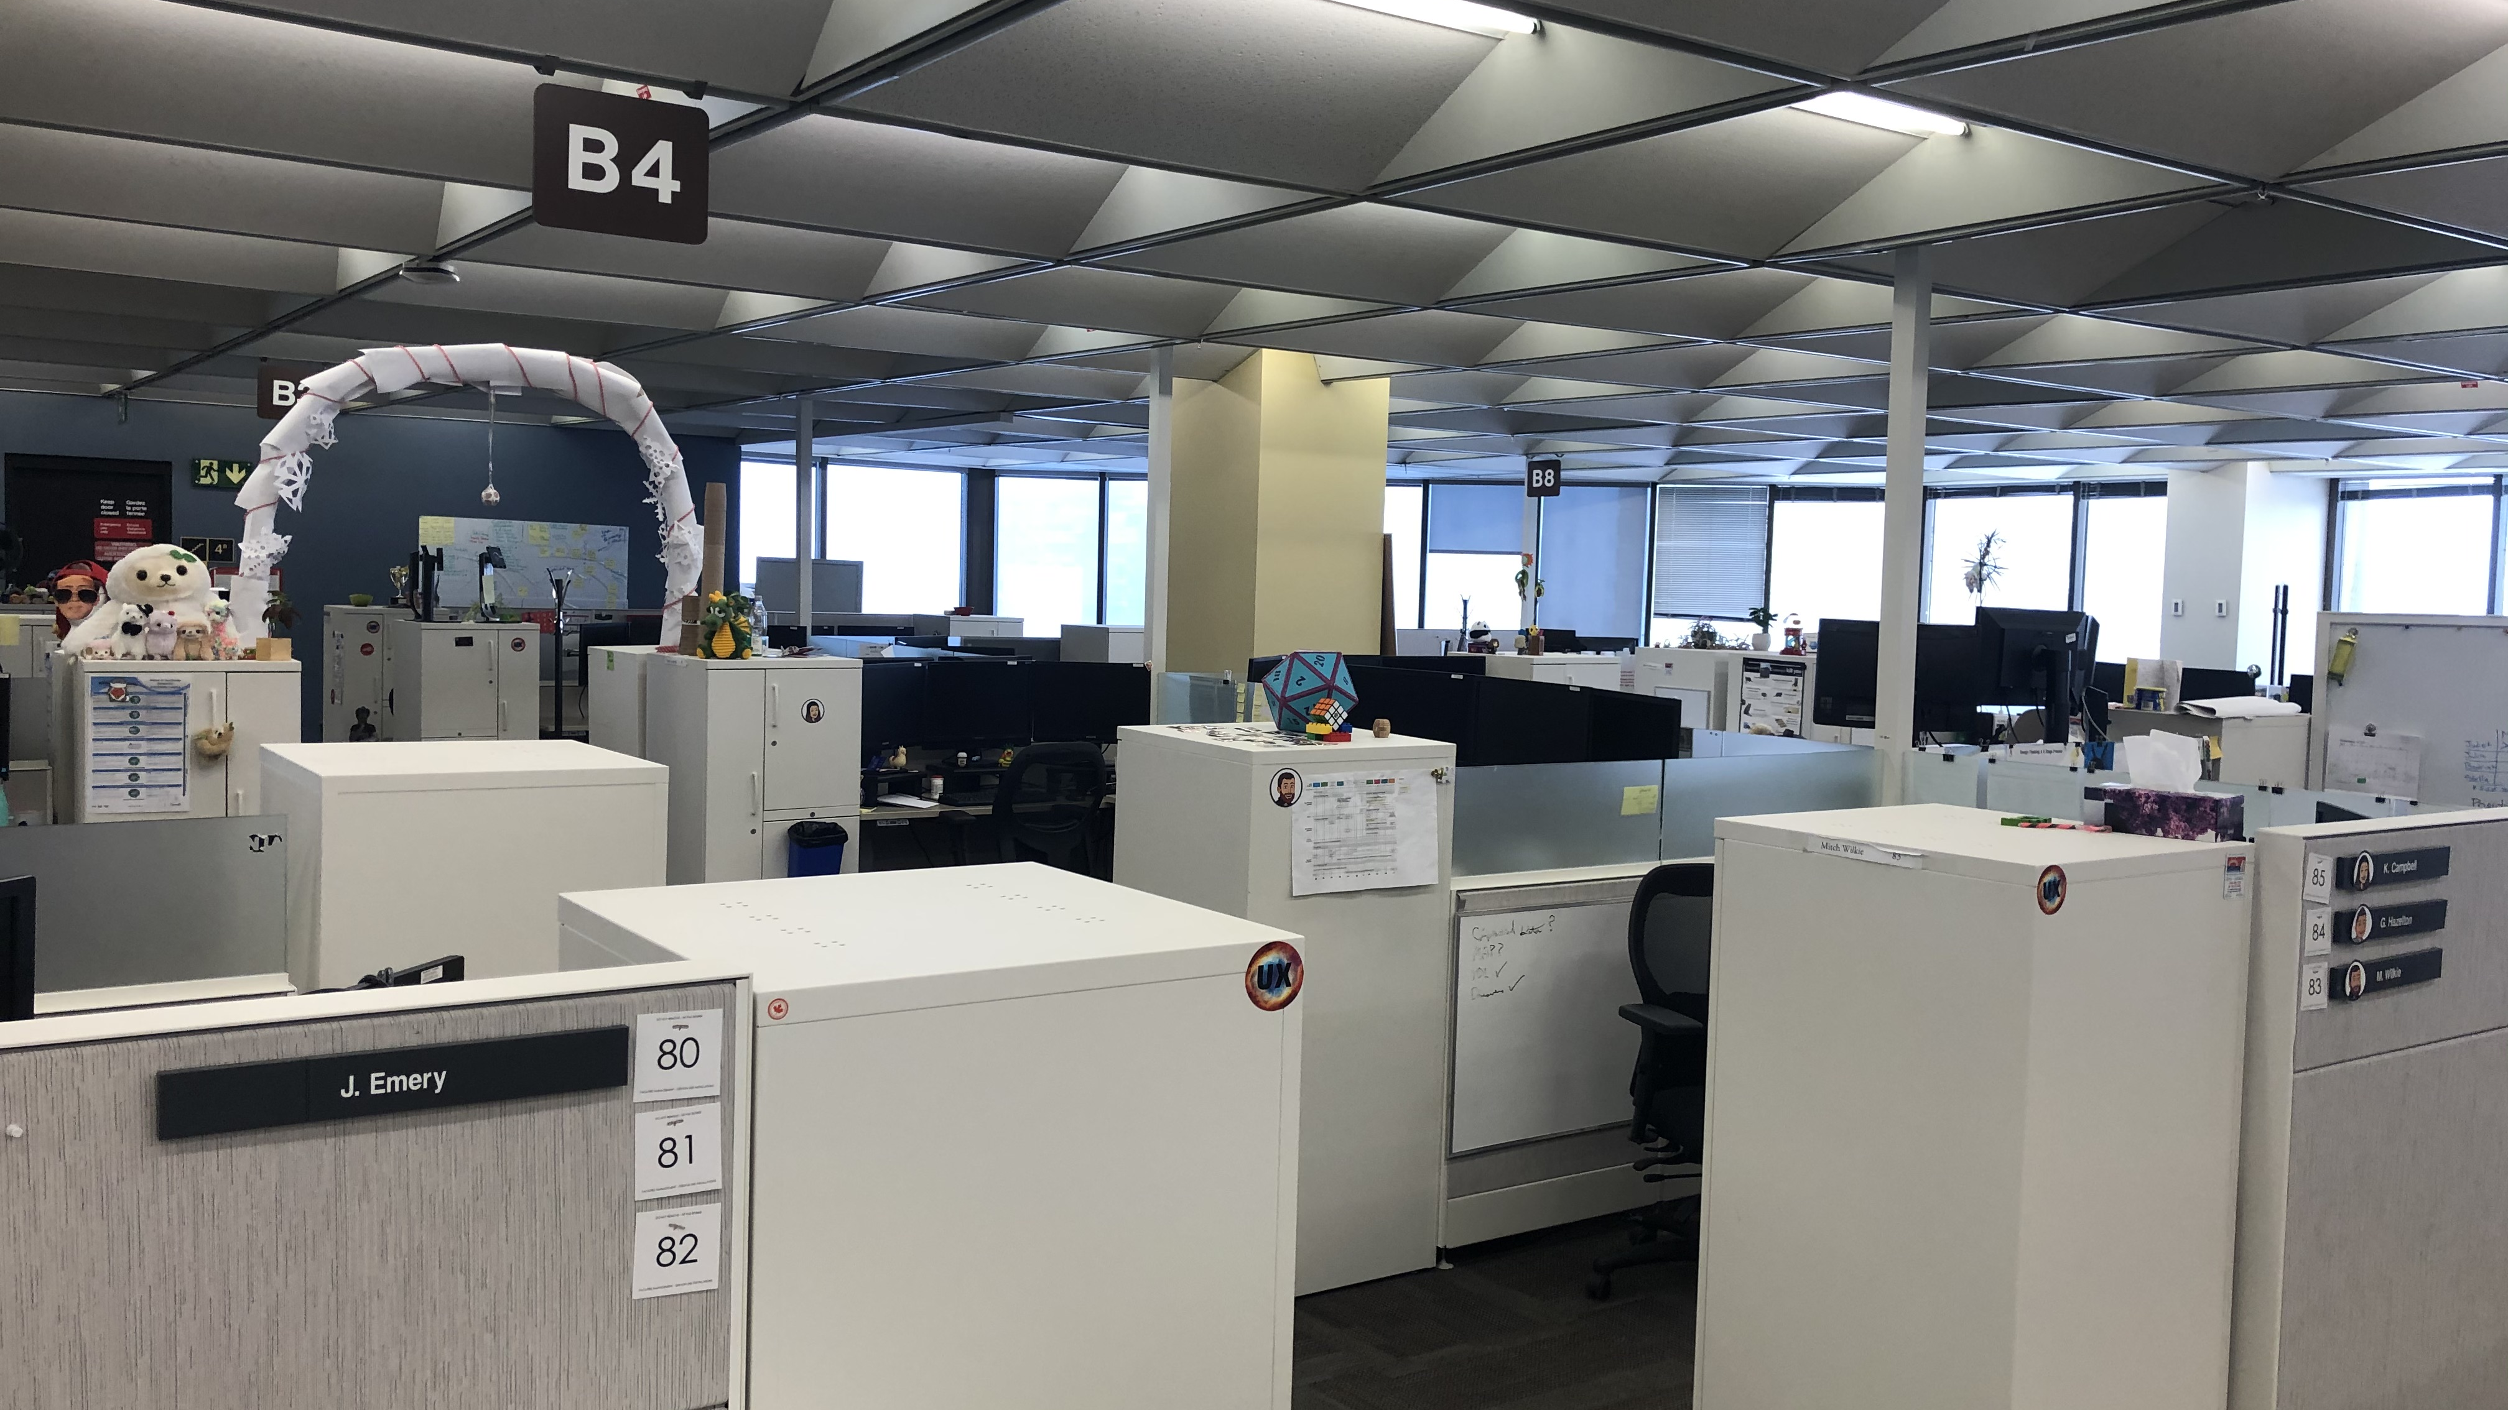
Notes:
Picture this:
You've just landed an amazing role on a super cool product team. Everyone on the team is filled with excitement.
And, as the first few days take shape, all of your past experiences that you’ve amassed start to feel like a work of fiction.
You start to convince yourself that it's only a matter of time before everyone realizes you're in way over your head.

Slide 3
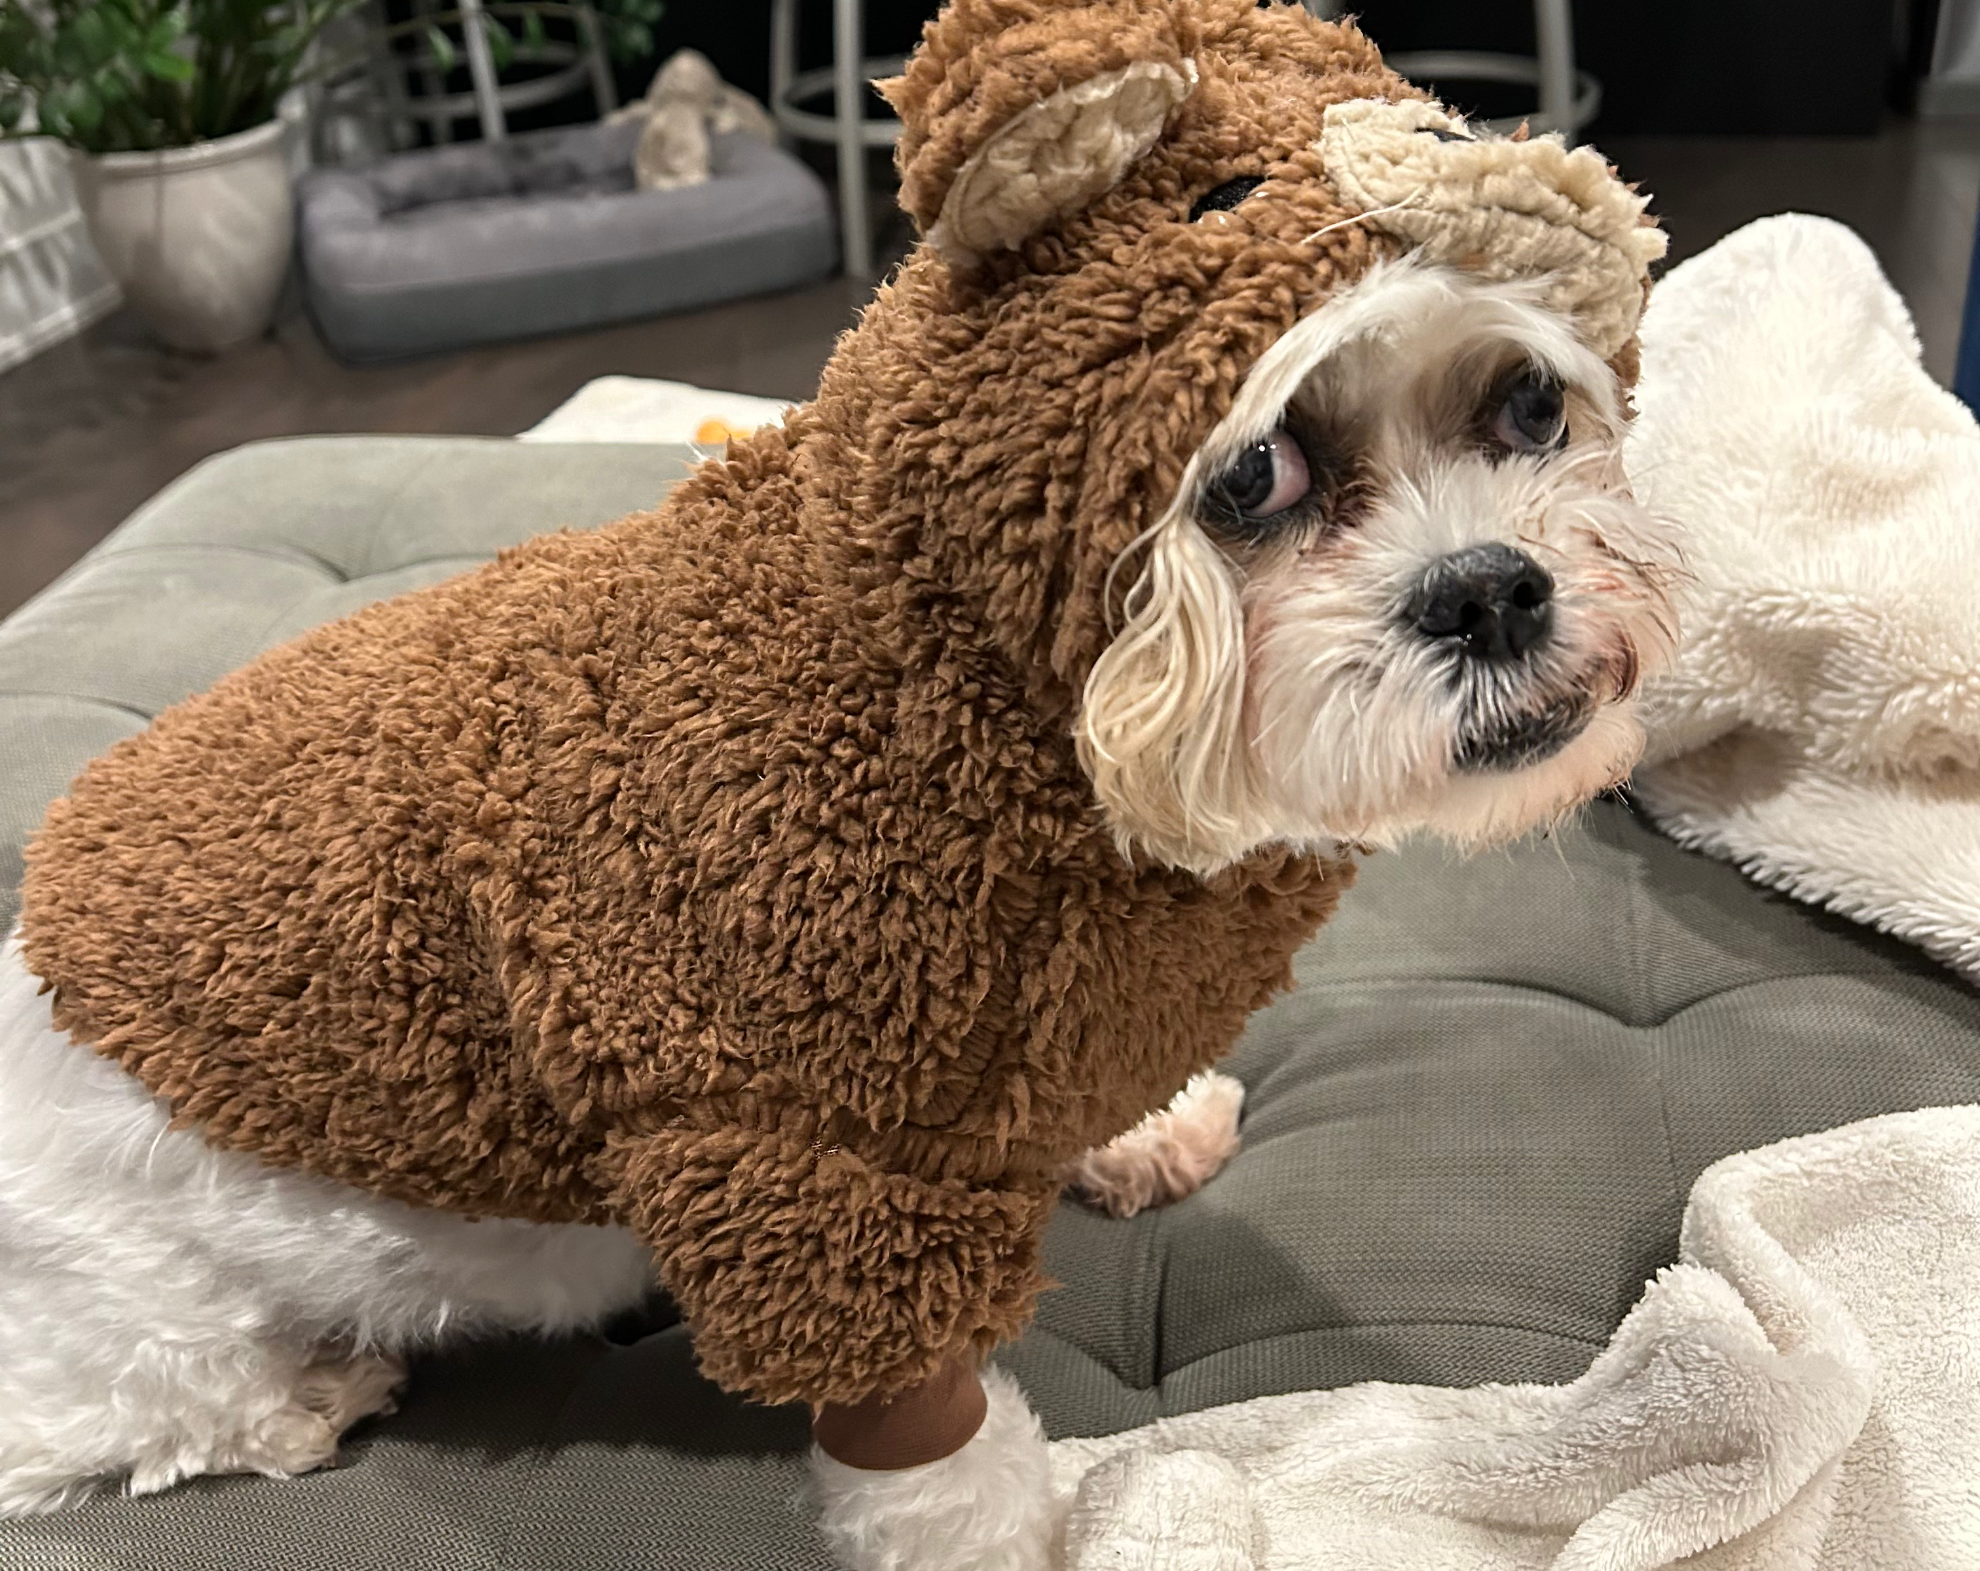
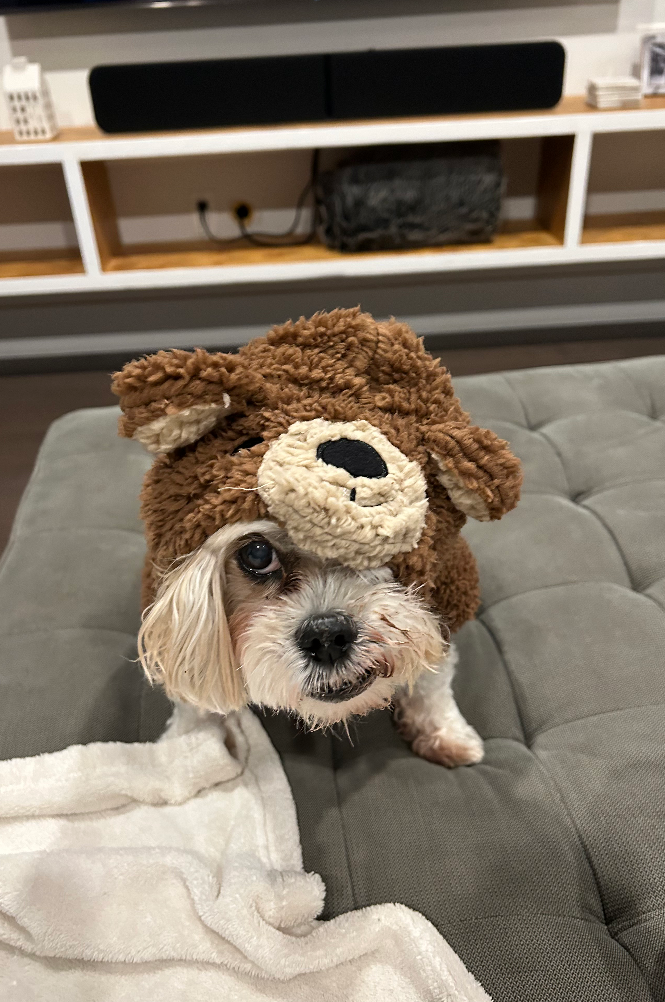
Notes:
I would like to share a story about a time in my own career that I experienced this.
On paper, I had all the skills needed - the experience, the knowledge, the educational background, everything.
But, wow, those first few weeks, I felt more and more like I just didn't belong there.

Slide 4

Notes:
What I didn't know then, but I know now, is that this feeling has a name - it's called Imposter Syndrome.
And this isn't just a few people wrestling with self-doubt. A number of people experience this at some point in their careers.
Even those who seem most confident around you.

Slide 5


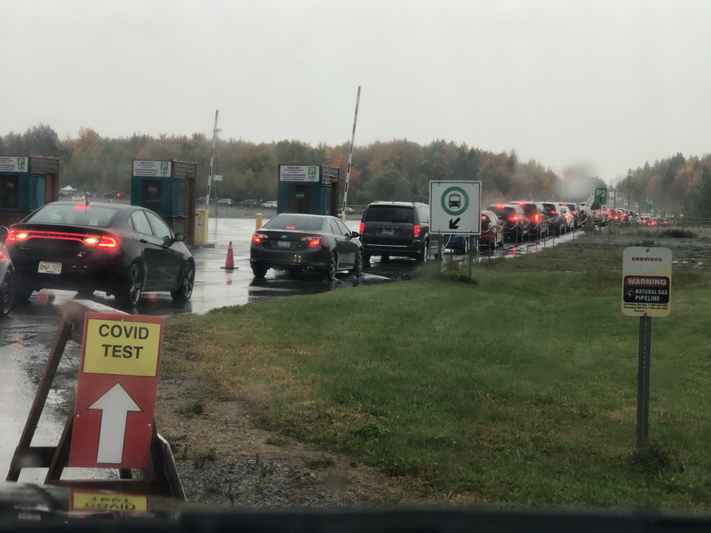
Notes:
Let’s go back to 2020.
Remember that? It was a really tough year.
We were all wiping down our groceries, learning how to make cookies, sour dough bread, and all of a sudden virtual cocktail making classes became a thing.

Slide 6
Notes:
So, for this story to make sense, you need to know what Code for Canada is.
Code for Canada is a non-profit organization that works with the public sector to enhance their digital capacity.
They embed a small team consisting of a product manager, UX designer, and developer for a 9 month engagement to collaboratively launch a product with their host organization.

Slide 7
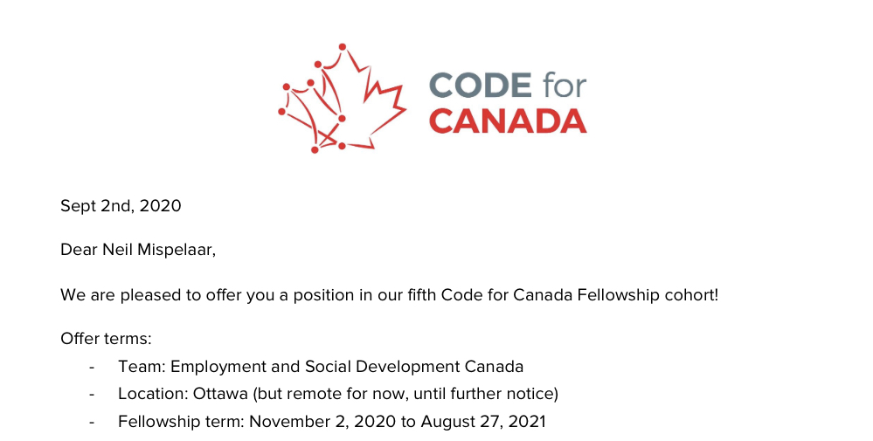
Notes:
In September 2020, I got a dream opportunity to join the C4C Fellowship in a developer role.
I had been offered a position.
I couldn’t believe it.
It was dream opportunity, I had to accept it. I was so excited.

Slide 8
Notes:
Orientation was so much fun!
I was paired with an amazing and talented team, Farwa and Thomas.
And our team was tasked with trying to reimagine how users would interact with a Service Canada digital agent. The Teams calls were electric.

Slide 9
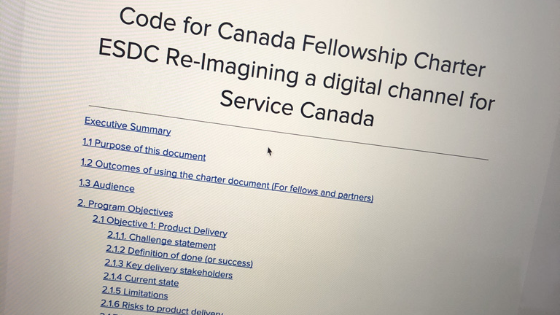
Notes:
After orientation, as those first few weeks on the ground unfolded, I started to have this incredible feeling that I didn’t belong. It wasn’t anything anyone said, it wasn’t what anyone else did, actually, everyone was so positive and so supportive, it was in my own head - I just didn’t believe I could do it.

Slide 10
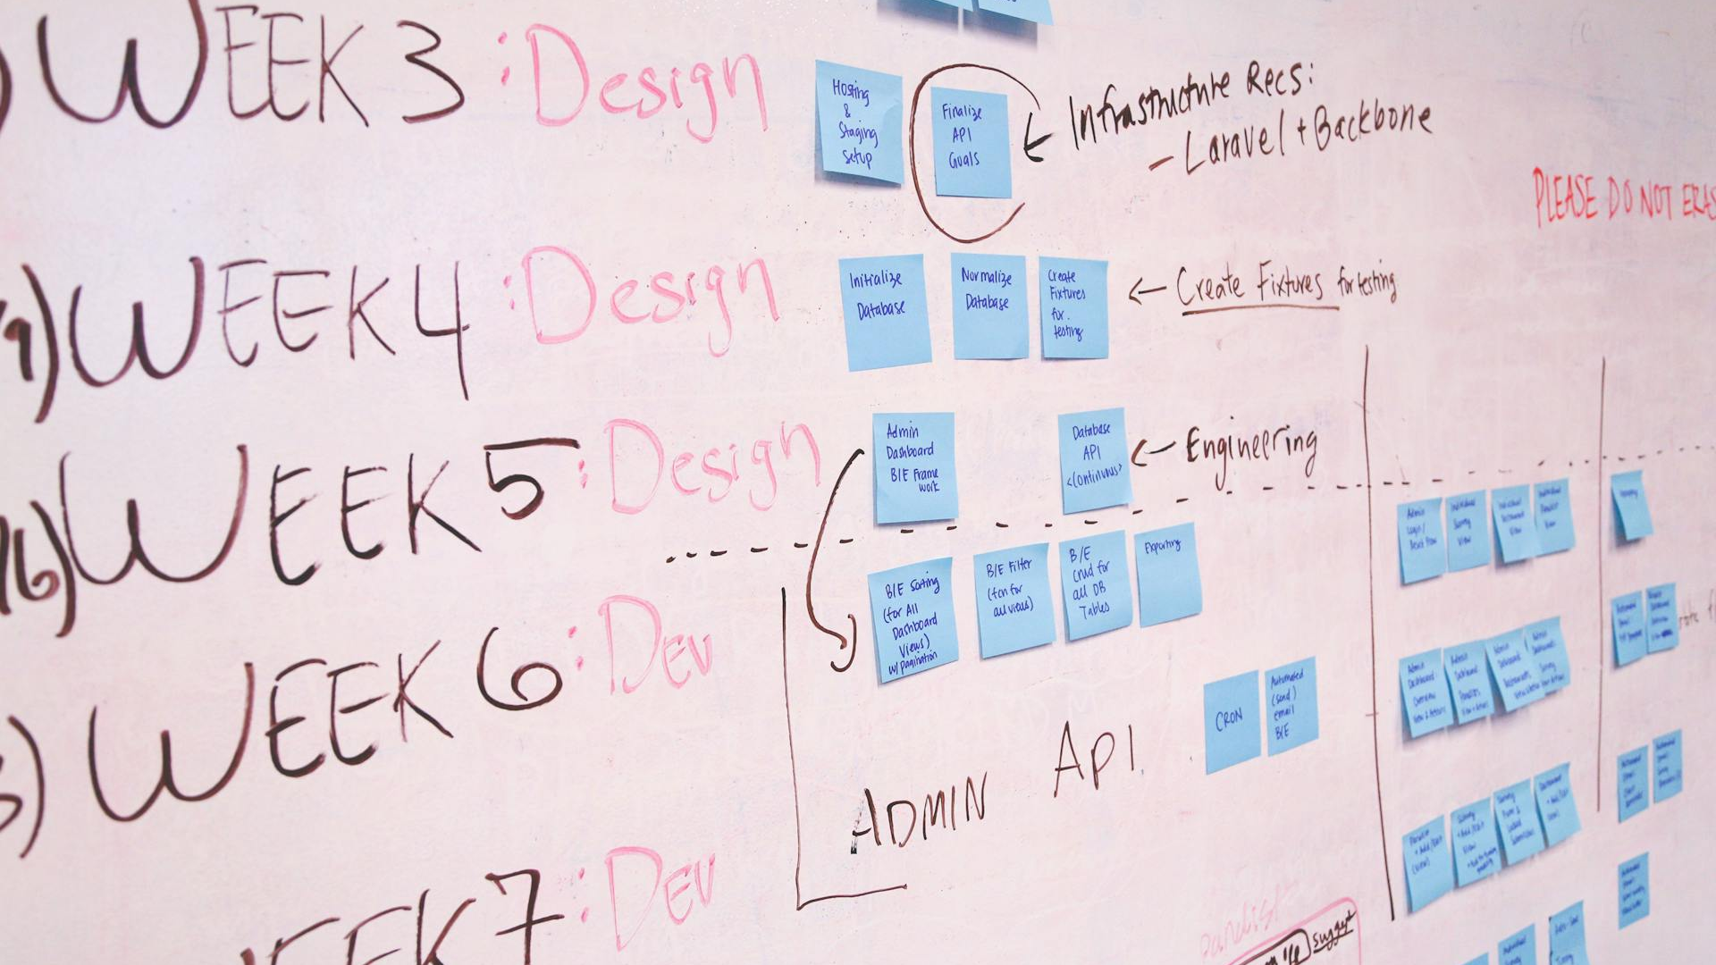
Notes:
And for a little while, it was a bit scary.
As more requirements came in, as more designs started to be drafted, the backlog of development work grew, it’s hard to describe the feeling of doubt that was manifesting, for a few weeks I really thought we were going to be the first C4C team that failed.
But, bit by bit, we started to build a thing.

